Slide 1
Car model detection and price estimation
IN THE NAME OF GOD
Winter 2020 – deep learning course project
Dr. pilehvar
By: Ali safarpoor dehkordi
& Amirhossein mansoubi hosseini

Slide 2
contents
Preface
Collecting dataset
Detecting car model
Related works
Solution and Challenges
Future works
Price estimation
Related works
Solution and Challenges
Future works
Question answering

Slide 3

preface
BAMA.IR

Slide 4
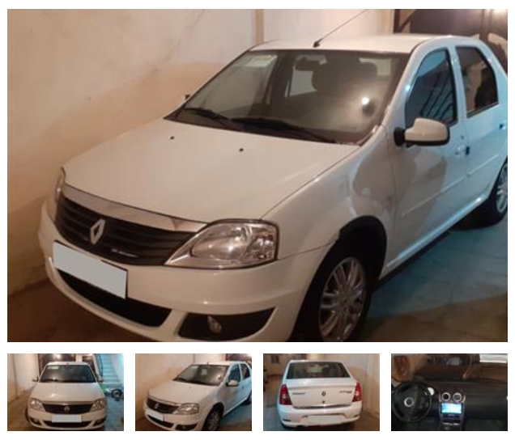
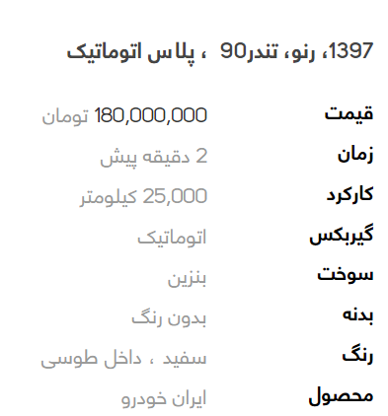
Collecting dataset
DATASET

Slide 5
Detecting car model
رنو ، تندر ۹۰

Slide 6
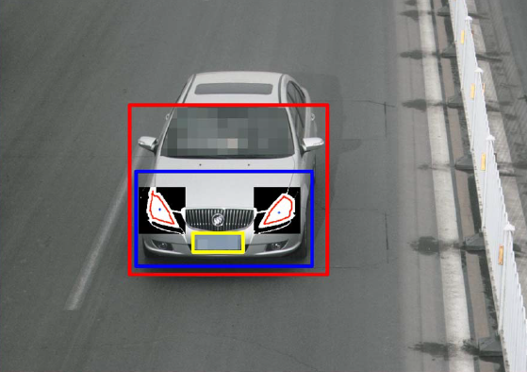
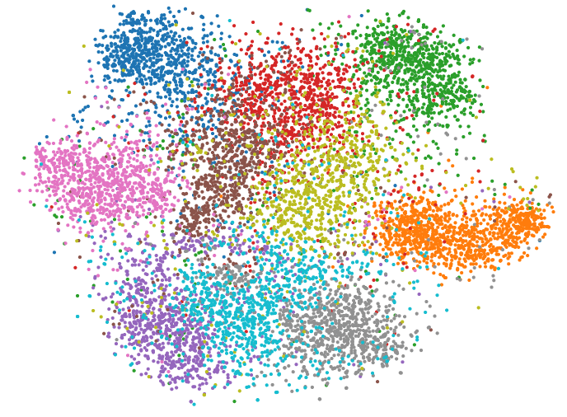
Detecting car model – Related works
Feature Extraction Machine Vision
KNN Algorithm

Slide 7
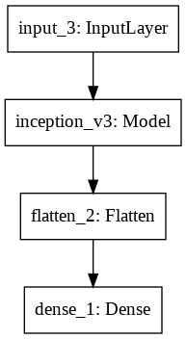
Detecting car model – solution & Challenges
300 * 450 images ➔ 150 * 225 ➔ NUMPY ARRAY
?
Loss Function : Categorical Cross-Entropy
Optimizer : Adam
Metric : Categorical Accuracy
Number Of Classes
At First : 433

Slide 8
Detecting car model – solution & Challenges
Callbacks:
EarlyStopping
ReduceLRonplateau
…

Slide 9
Detecting car model – solution & Challenges
Conv2D + Pooling + Conv2D + … ➔ 7%
VGG16 ➔ 7%
MobileNET ➔ 7%
ResNET50 ➔ 7%
InceptionV3 ➔ 14%

Slide 10
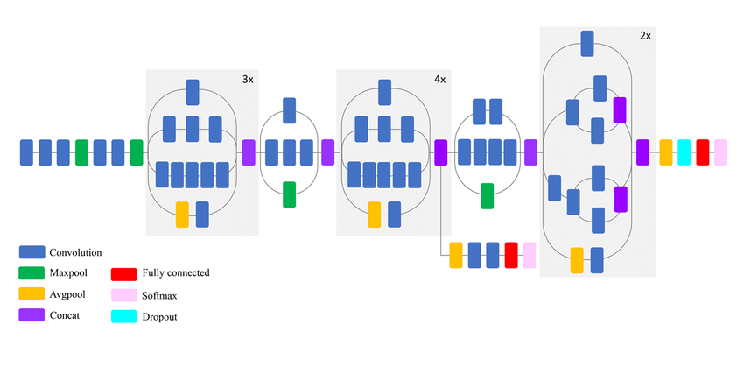
Detecting car model – solution & Challenges
Froze !
➔ 27%

Slide 11
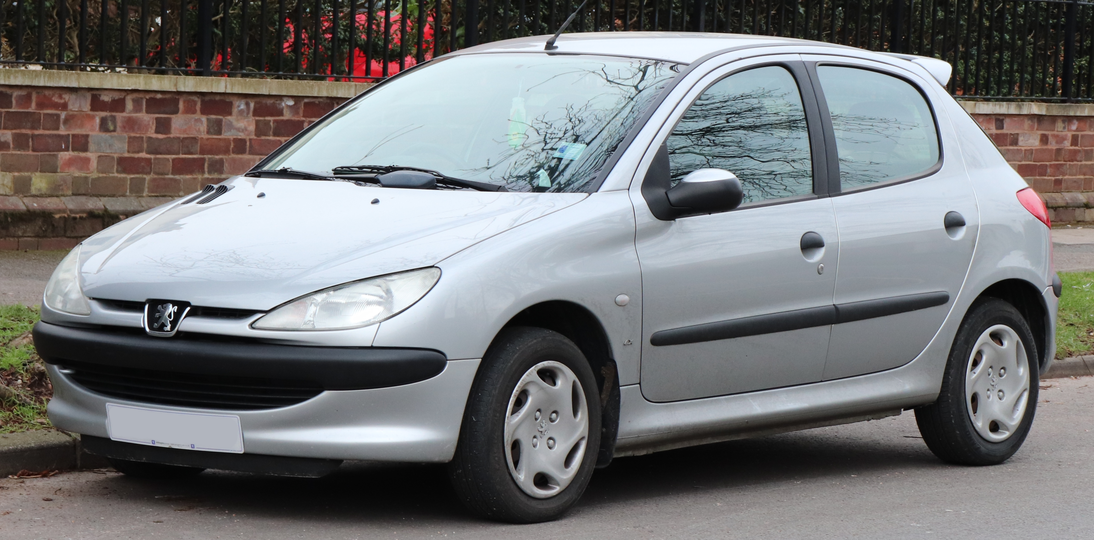
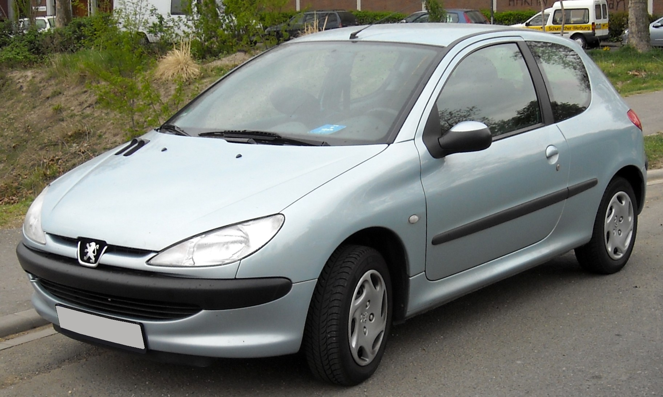
Detecting car model – solution & Challenges
TYPE 5
206 !
TYPE 2

Slide 12
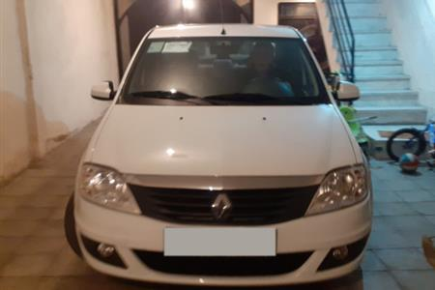
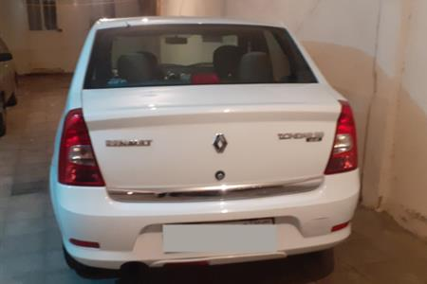
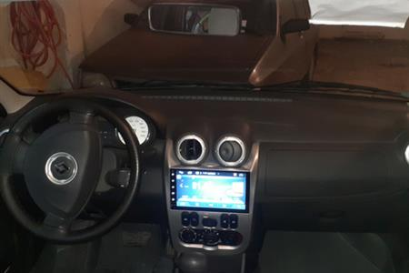
Detecting car model – solution & Challenges

Slide 13
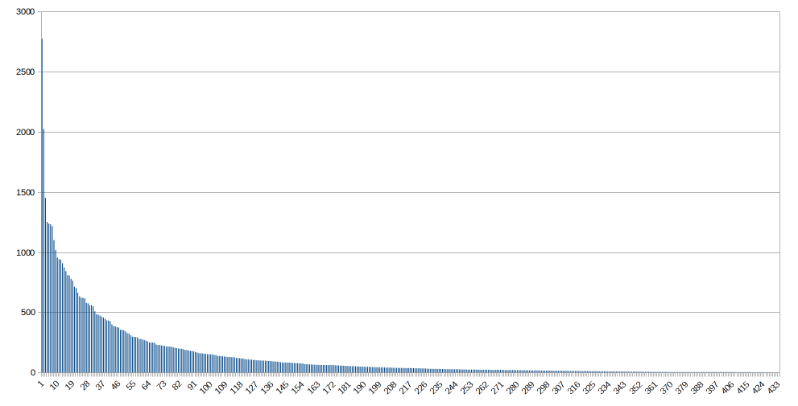
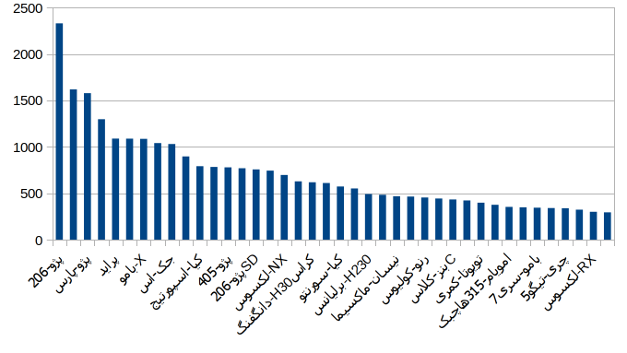
Detecting car model – solution & Challenges
433 classes
40 classes

Slide 14
Detecting car model – solution & Challenges
40 classes
Almost 28000 pics ( half of all )
Average = 710 pic in each class
➔ 72%

Slide 15
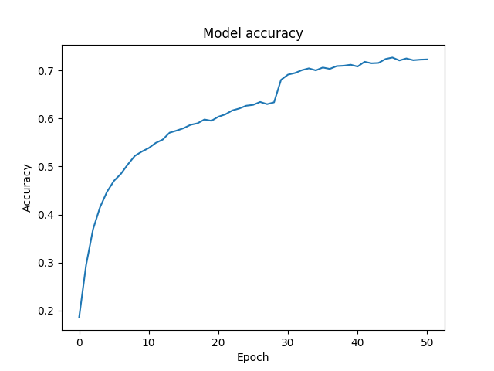
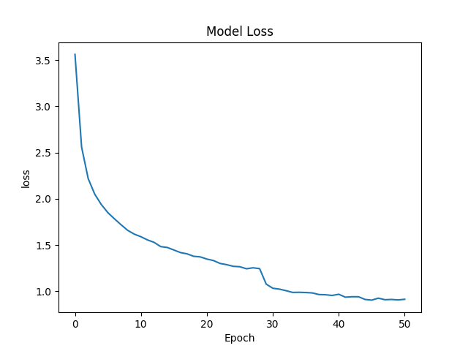
Detecting car model – solution & Challenges
LR reduced

Slide 16
Detecting car model – solution & Challenges
TEST !
NEW 2000 Pics Downloaded & Cleaned
Result ➔ 60%

Slide 17
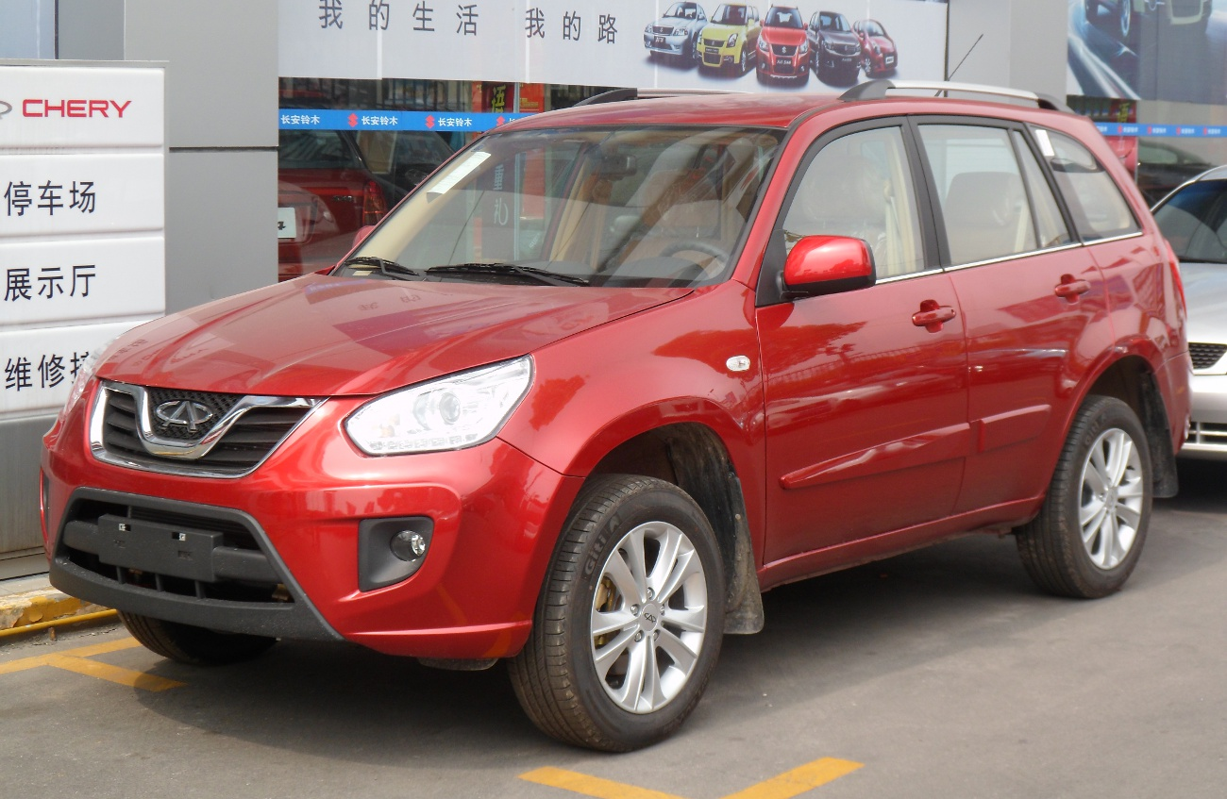
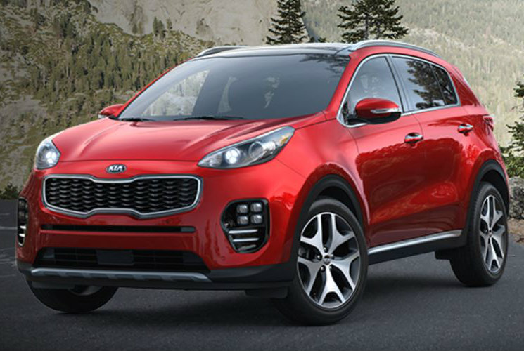
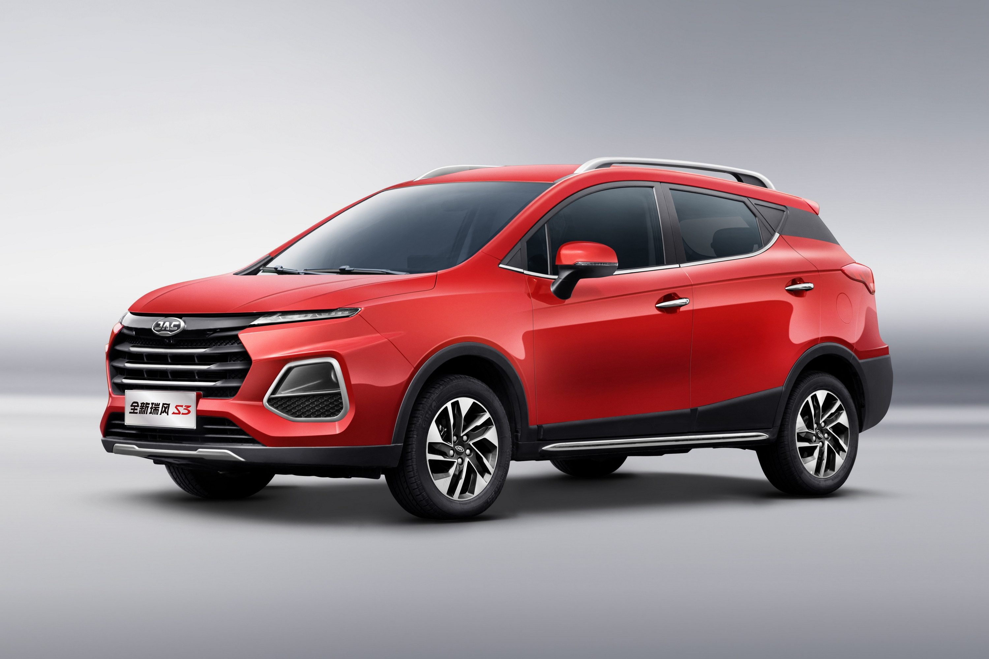
Detecting car model – solution & Challenges
WHY 60% ? ➔ we looked at wrong answers
TEST !
Cherry Tiggo
KIA Sportage
JAC S3
The network Considers SHAPE more than DETAILS

Slide 18
Detecting car model – Future works
Visualize last layer Filters ➔ Why details are not important in network
Collecting larger dataset
Cleaning pics better !

Slide 19
Price estimation
?
180,000,000 T

Slide 20
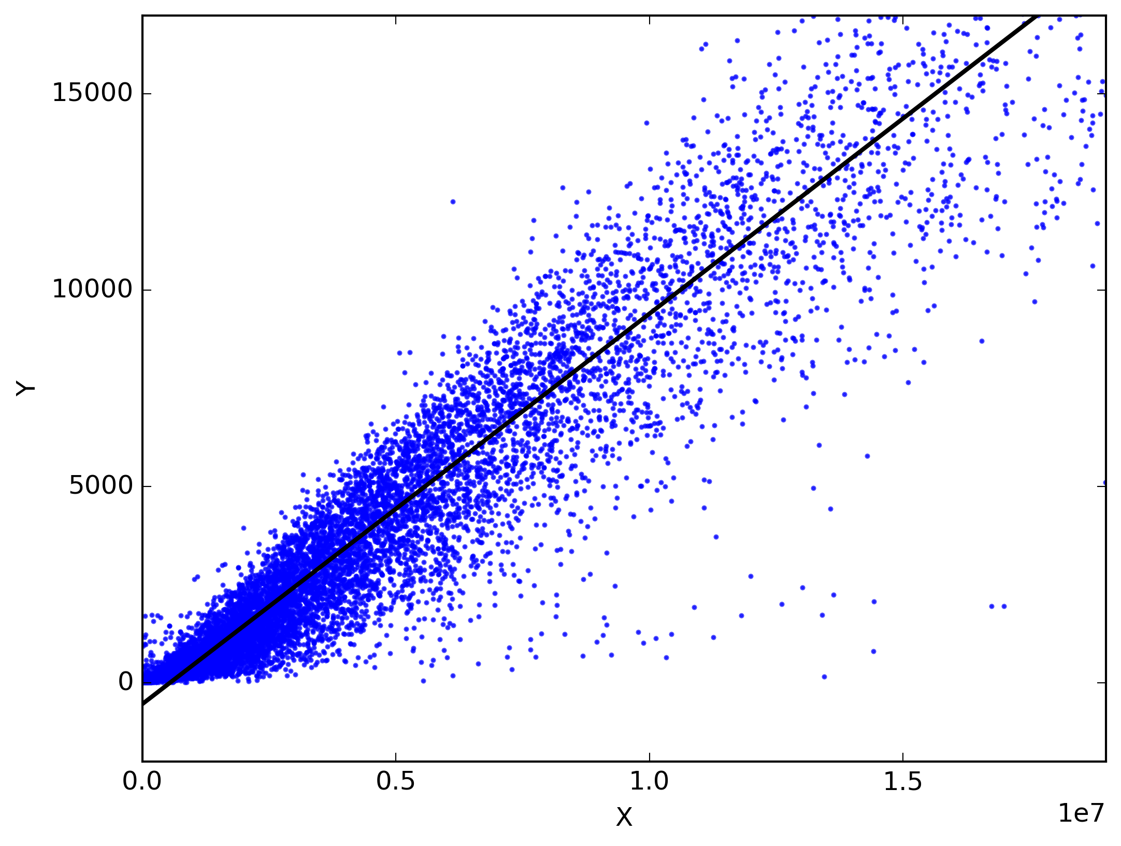

Price estimation – related works

Slide 21
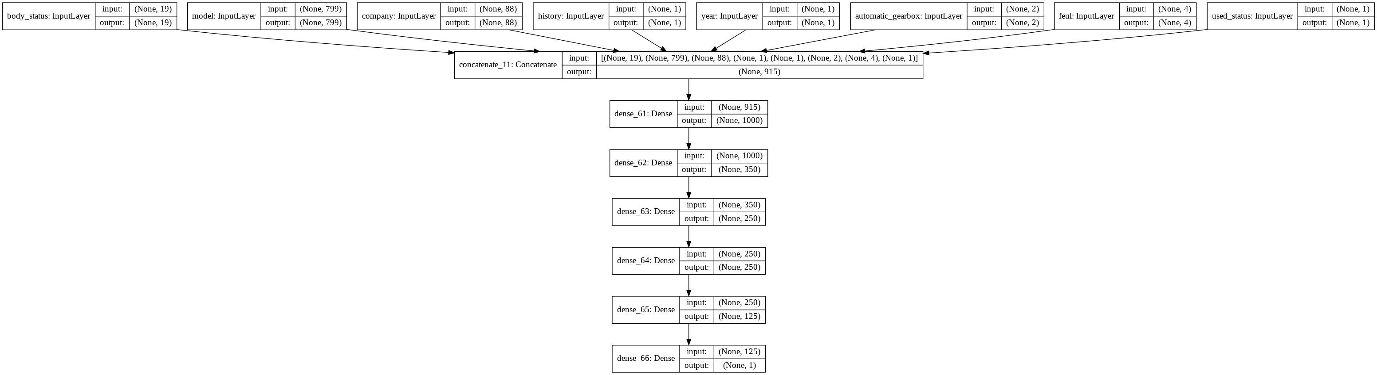
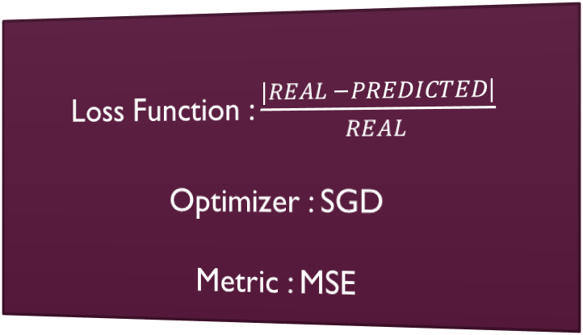
Price estimation – solution & Challenges
Callbacks:
EarlyStopping
ReduceLRonplateau
…
Loss Function : $\frac{|REAL −PREDICTED|}{REAL}$
Optimizer : SGD
Metric : MSE

Slide 22
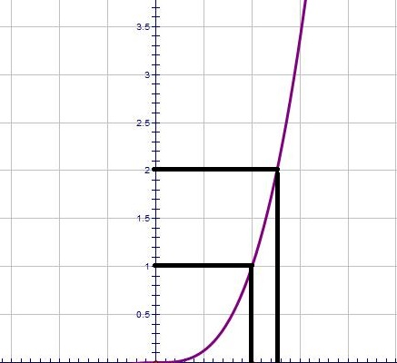
Price estimation – solution & Challenges
Preprocess :
colors , body status , name and model ➔ one-hot
Extra Feature : Used or New ?
Price , Worked distance , Production year ➔ Special Function

Slide 23
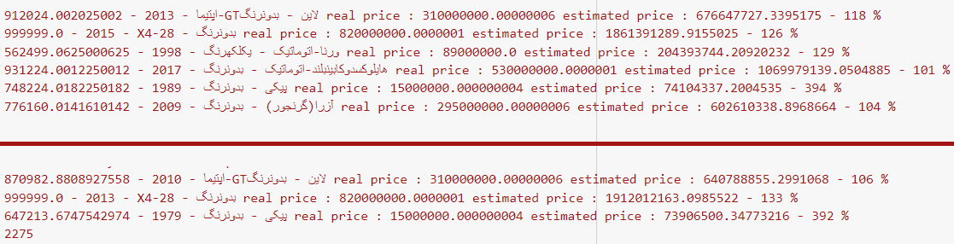
Price estimation – solution & Challenges
Delete some malicious data

Slide 24
Price estimation – solution & Challenges
At first ➔ 20% Loss
Deeper Network ➔ 14%
Preprocess Data ➔ 8%
Change Loss Function ➔ 7%
Delete Unnecessary Features ➔ 6%
Delete some malicious data ➔ 5%

Slide 25
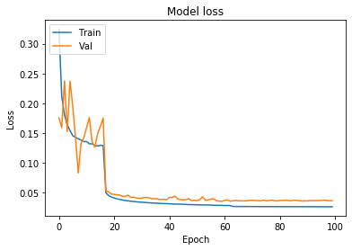
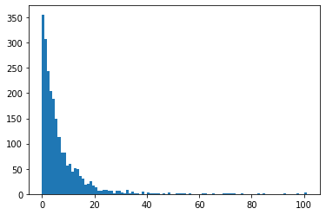
Price estimation – solution & Challenges
Histogram

Slide 26
کارهای آینده
Thanks for Watching
Question?

